Slide 1
UNIT 3:
Ecosystems

Slide 2
Ecosystem
What is an ecosystem? (Likens, 1992)
“a spatially explicit unit of earth that includes all of the organisms [plants and animals], along with all the components of the abiotic [non-living] environment within its boundaries.“

Slide 3
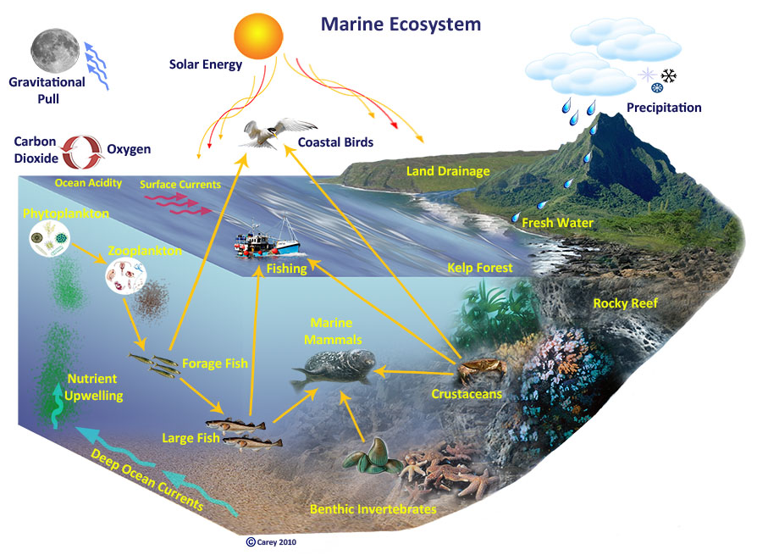

Slide 4
Ecosystem
Activity 3.1: What comprises local marine ecosystems?
Discussion

Slide 5
Food chains
Food chains describe the connections between different elements of an ecosystem
For example:
plants use the sun’s energy for growth and normal functioning
herbivores eat plants for growth and functioning
other species eat herbivores, etc.
Example food chain:
Sunlight --> Algae --> Parrotfish --> Coral trout --> Shark

Slide 6
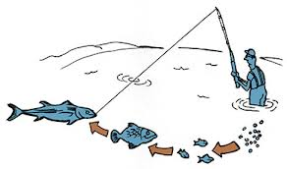
Food chains
Activity 3.3: Partner up and describe at least one food chain (local examples)

Slide 7
Foodwebs
Foodwebs describe the complex inter-linkages among all organisms in an ecosystem – comprise many food chains.
Activity 3.4: Class to construct a local food web. Discuss.

Slide 8
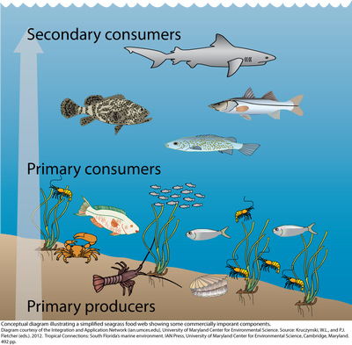
Trophic levels
Trophic levels in a foodweb reflect: how an organism provides energy to other organisms and how an organism relies on energy from other sources.

Slide 9
Trophic levels
Trophic levels:
Primary producers: Plants and algae that make their own food.
Primary consumers: Herbivores that eat plants.
Secondary consumers: Carnivores that eat herbivores.
Tertiary consumers: Carnivores that eat other carnivores.
Apex predators: have few predators and are at the top of the food chain.

Slide 10
Trophic levels
Activity 3.5: Identify organisms from the class food web and the trophic level where each belongs.

Slide 11
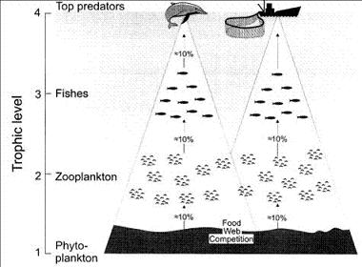
Energy pyramid
The energy pyramid demonstrates the energy loss in ecosystems as we move up the food chain, ie. moving up through trophic levels.

Slide 12
Connectivity
Connectivity describes how plants and animals can be connected among different habitats.
For some species they can move throughout the ecosystem their entire life
For other species they may use particular habitats during different stages of their life
For example:
the red emperor, Lutjanus sebae (See poster)
larval transport/movement between no-take areas and fished areas (more on movement later)

Slide 14
Unit review
Ecosystems are comprised of many biotic AND abiotic elements.
A food chain describes links between organisms based on what they eat.
A food web describes the complex inter-linkages of many food chains.
Trophic levels describe the source of energy of different organisms.
Energy is lost as we move up trophic levels.
Connectivity describes linkages among different organisms and also among different habitats and life history stages.

Slide 15
Ecosystems
15 minute personal review: unit review, students to review main concepts of unit in the course notes, contribute any new words (new to them) to their own personal glossary in the back of their notebook (local language equivalent terms should also be recorded where possible)

